Slide 1
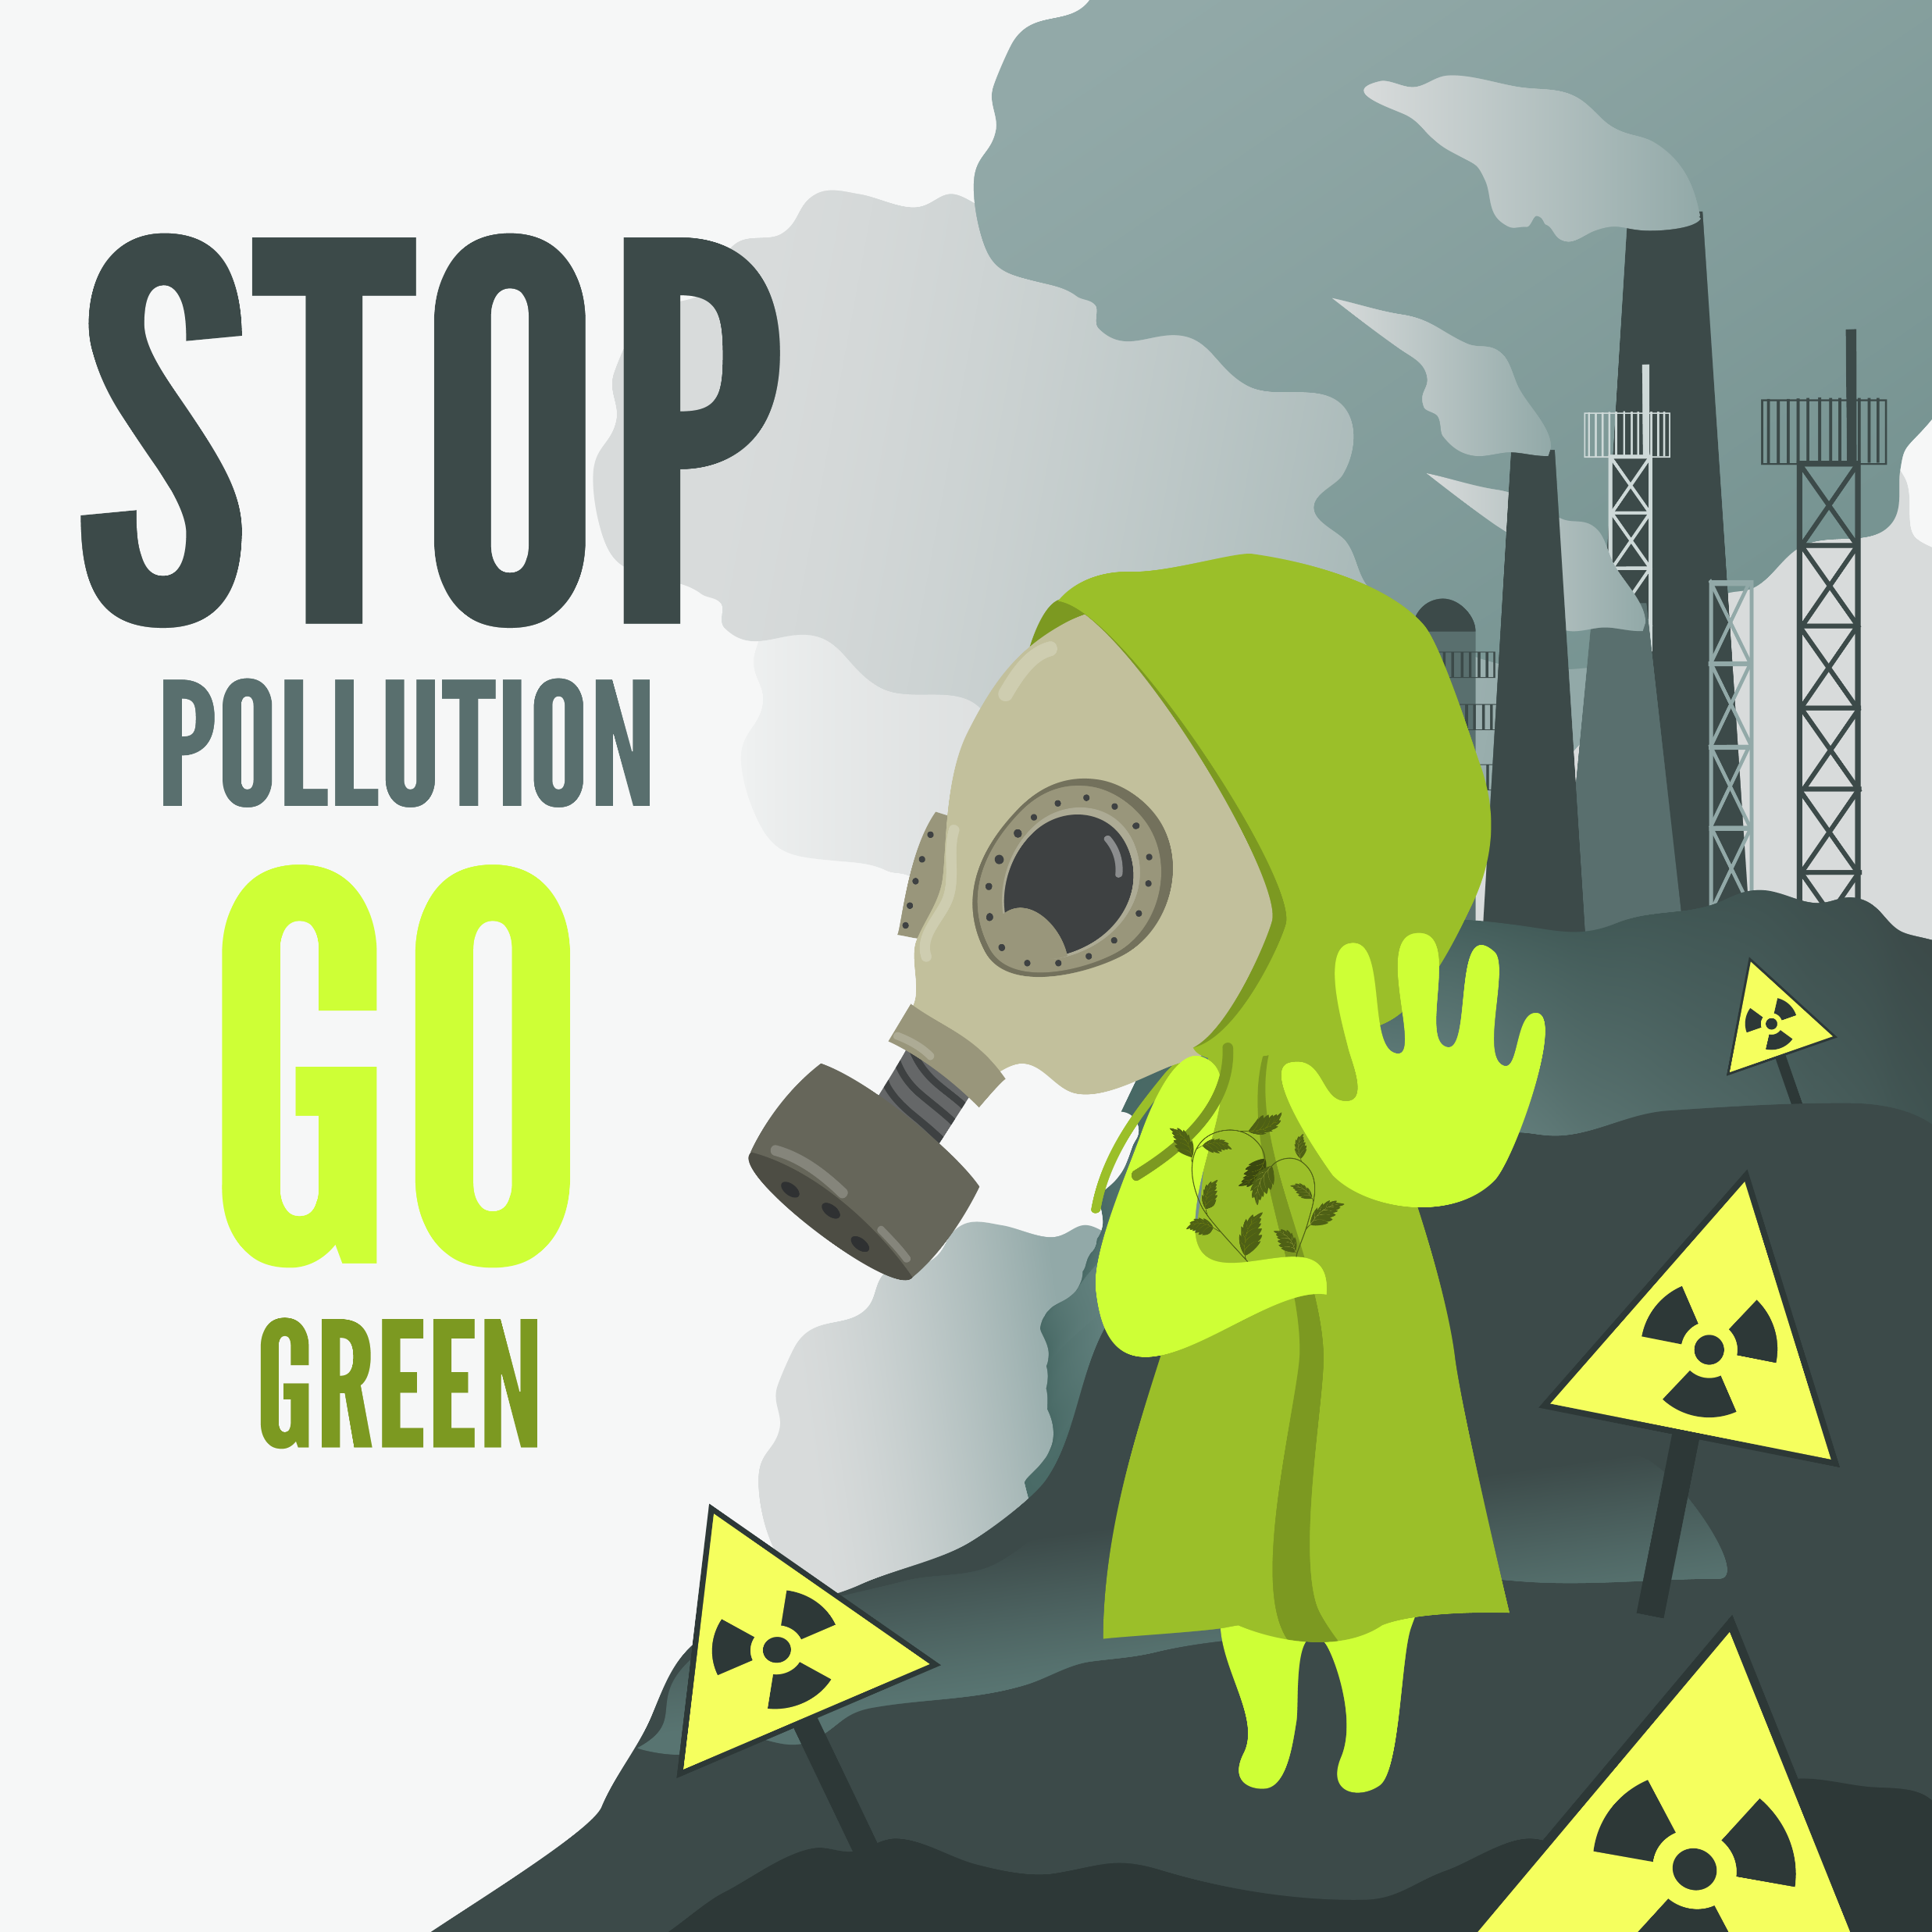
The Health Impacts and Mortality Risk of Air Pollution
Team - 13
Farman Syed
Marivic Tanguin
Ali Heidari.
Sameen Shahzad
Team Member

Slide 2
Project Description Purpose
The purpose of this study is to investigate the health impacts and mortality risk of air pollution, including ambient household air pollution, ambient particulate matter pollution, ambient ozone pollution, and air pollution caused by solid fuels. By examining exposure to these types of pollution, we aim to gain a better understanding of the risks associated with air pollution and identify potential strategies to mitigate its harmful effects on human health.
Scope
Limitations
The study covers a period of 30 years (1990-2019) and includes data on air quality, mortality rates, and disease burden associated with air pollution from a variety of countries and regions. The focus is on the health impacts and mortality risk associated with exposure to different type of air pollution.
The study is limited by the availability and quality of data, which may vary by country and over time. In addition, the study focuses on selected types of air pollution and does not cover all possible sources of air pollution, such as industrial emissions or transportation-related pollution.

Slide 3
Research Questions
Overview
Ambient Air Quality Data
The analysis focuses on the air quality levels, specifically PM25, PM10, and NO2, in the top 10 countries
25%
Outdoor Pollution Rates by Ages
The study will examine the relationship between exposure to air pollution and mortality rates and disease burden. This will involve analyzing air quality data from different countries and regions, as well as mortality rate and disease burden data related to air pollution. We will use statistical analysis and modeling techniques to identify patterns and relationships between exposure to different types of air pollution and health outcomes.
25%
The analysis focuses on the top 10 countries where air pollution is a leading cause of death across different age groups
25%
AQ Pollution Mortality Data
The analysis compares the causes of death due to different types of pollution with the impact of air pollution
Disease burden by Risk Factor
The analysis involves comparing the Disability-Adjusted Life Years (DALY) attributed to various diseases
25%

Slide 4
DEMO

Slide 5
DATA EXPLORATION
& CLEANING
We have gathered data from following resources
World Health Organization (WHO)
Global Alliance on Health and Pollution (GAHP)
kaggle.com
For Data Cleaning we used Python & Jupyter Notebook

Slide 6
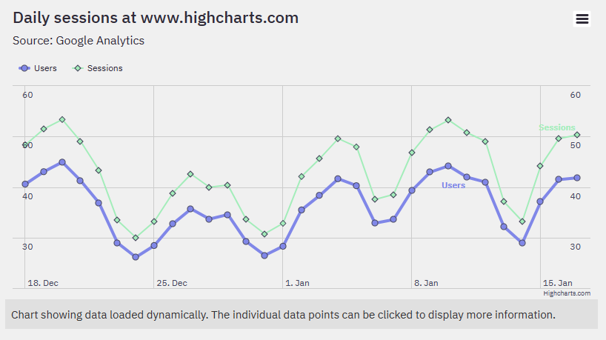
Outdoor Pollution Rates by Ages
The analysis focuses on the top 10 countries where air pollution is a leading cause of death across different age groups, with the aim of determining whether it disproportionately affects either the young or the old.

Slide 7
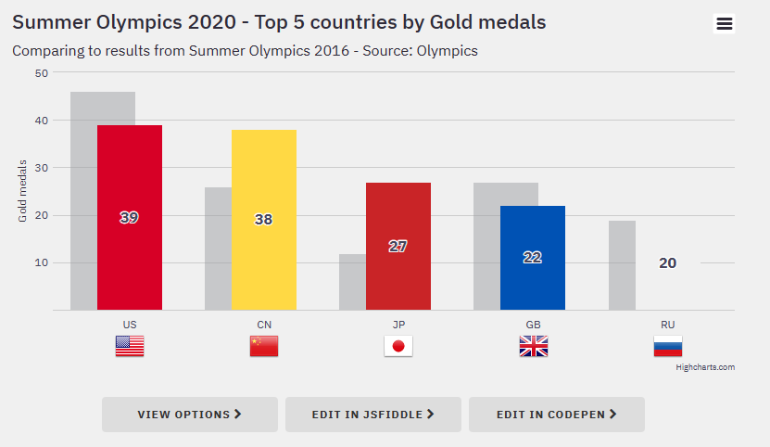
Death Rates from Air pollution
The analysis examines the top 10 countries where air pollution is a major cause of death, categorized by the type of air pollution, such as household pollutants or ozone, with the objective of gaining insights into the most harmful sources of air pollution in these countries.

Slide 8
Ambient Air Quality Data
Research Questions
Overview
The analysis focuses on the air quality levels, specifically PM25, PM10, and NO2, in the top 10 countries
25%
Outdoor Pollution Rates by Ages
The study will examine the relationship between exposure to air pollution and mortality rates and disease burden. This will involve analyzing air quality data from different countries and regions, as well as mortality rate and disease burden data related to air pollution. We will use statistical analysis and modeling techniques to identify patterns and relationships between exposure to different types of air pollution and health outcomes.
25%
The analysis focuses on the top 10 countries where air pollution is a leading cause of death across different age groups
25%
AQ Pollution Mortality Data
The analysis compares the causes of death due to different types of pollution with the impact of air pollution
Disease burden by Risk Factor
25%
The analysis involves comparing the Disability-Adjusted Life Years (DALY) attributed to various diseases

Slide 9
The Health Impacts and Mortality Risk of Air Pollution
Team - 13
Farman Syed
Marivic Tanguin
Ali Heidari.
Sameen Shahzad
Team Member

